Slide 1
DALAN SHOES
Kelompok :
- Gilland nafis sutarda
- Muhamad dani setiawan

Slide 2




System Summery
Dalan Shoes is a place where people can buy shoes provide by the website. This web is easy to use and dynamic. We make this web using :
BOOTSTRAP
HTML - CSS - JS
JSON
ANGULARJS

Slide 3
System Processes
REGISTER PAGE
There are 5 main page . Each of them have a different purpose, Home page is the first page that user will open to, user will be approach by list of shoes that for sell on the web. If user choose one of the list they will switch to the page contain detail of the items to buy user choose the size and click add to chart, then the user can fill the form and check out. User can register or login with an existing account.
LOGIN PAGE
CONTACT US PAGE
HOME PAGE
CHECKOUT PAGE
SHOP LIST PAGE
CART PAGE

Slide 4
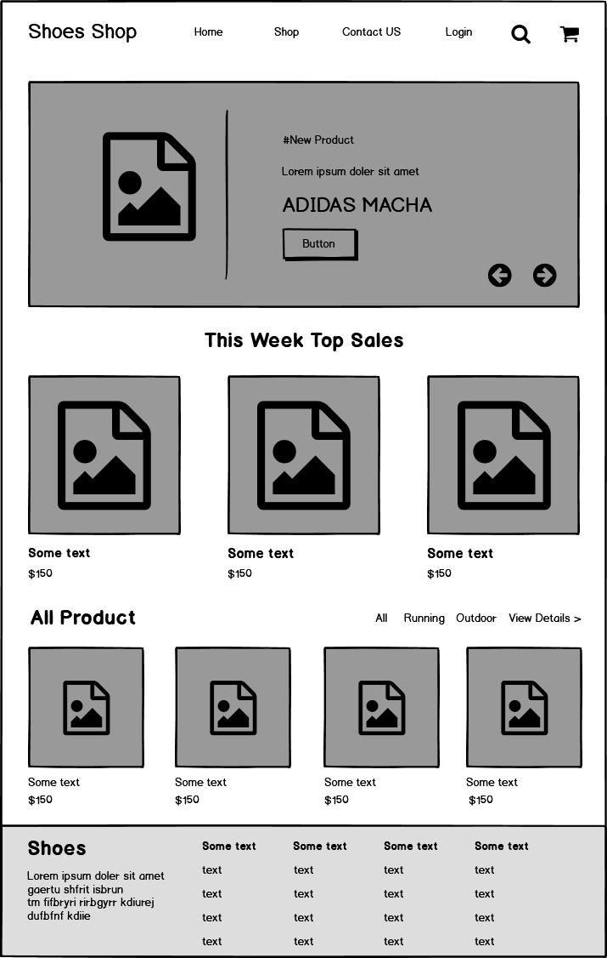
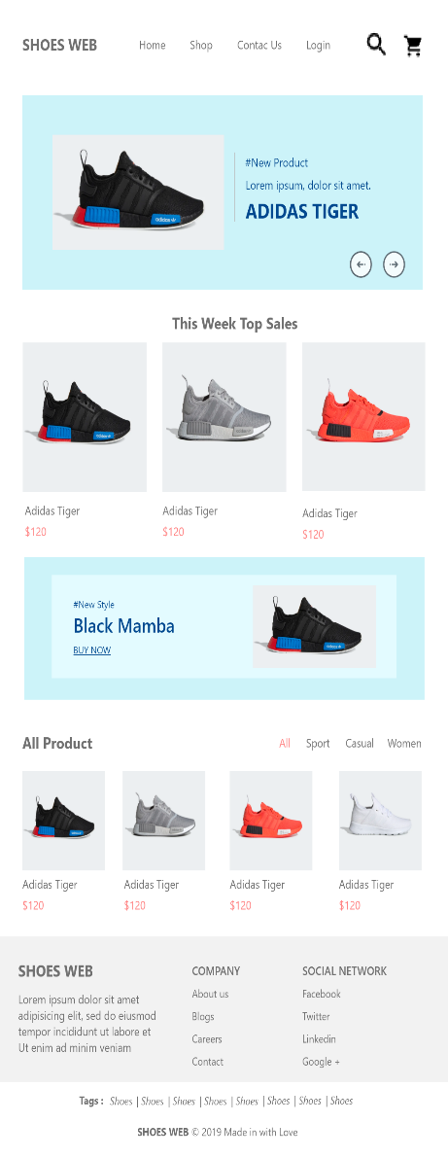
Wireframe and Mockups

Slide 5
Demonstration

